Slide 1

COWIDE Analytics Team:
Amitha Unnikrishnan
Tirumala Keerthisri
Doddla Thrushna Reddy

Slide 2
INTRODUCTION
COWIDE is an open-source web-application to know the current COVID-19 scenario across the globe.
Insight helps R&D, government and students to strengthen their social
awareness.
Data analysis to deliver correct and up-to-date information.
Graphical Representation, Custom Search and Flag to review.

Slide 3
ENVISIONED SOLUTION
Angular based Responsive Single Page Application (SPA)
Authentication for Registered Users and Easy Navigations.
Third Party APIs to provide data of COVID-19 cases daily and provide Pictorial Analysis.
Spring Microservices based Search analysis on Continent, Country, Date.
Flag Services to mark cases history and further analysis.

Slide 4
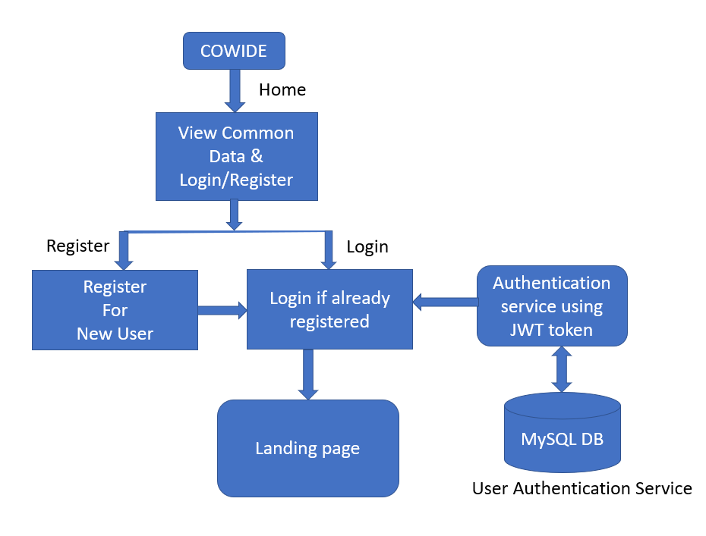
WORK FLOW DIAGRAM
Pre - Login:

Slide 5
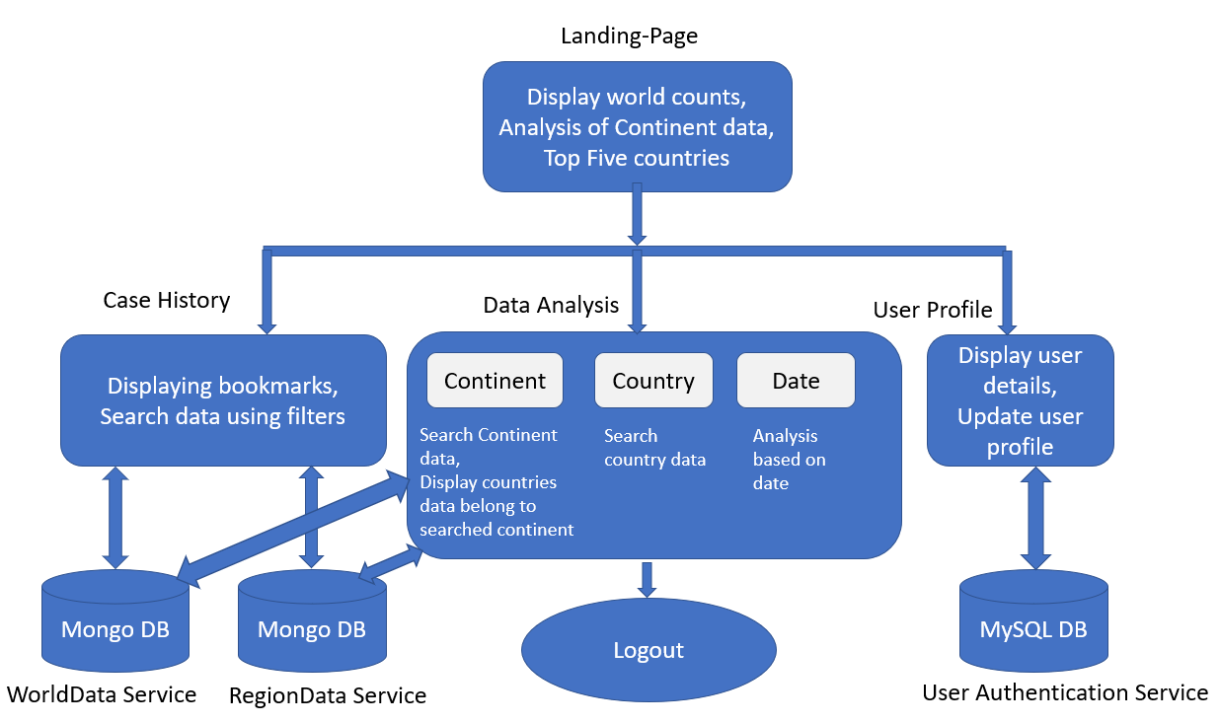
Post - Login:

Slide 6
TECHNOLOGIES
Technologies: Angular, Microservices, REST API, Authentication, Docker Containerize, Gitlab CI/CD
Web Technologies: HTML5&CSS3, Bootstrap4, Typescript
Databases: MySQL, MONGODB
Framework: Angular, Spring
Spring Cloud Pattern: Netflix – Eureka ,Netflix - Zuul API Gateway
Logs: AOP , logger
Testing Frameworks: Swagger, Postman
Testing Technologies: Junit, Mockito, Jasmine, Karma, Protractor
IDE: Spring Tool Suite, Visual Studio Code, Gitlab ,Docker Hub

Slide 7
DEVELOPMENT PHASE
Micro Services:
UserAuthentication Service
WorldData Service
RegionData Service
JWT Authentication
Angular – Canactivate Guards, Routing , Material UI , API Calls
Netflix Eureka and Zuul Gateway Implementation
GitLab CI/CD
Containerized Docker Images

Slide 8
TESTING PHASE
AOP – Logger
Swagger UI
Mockito Tests :
UserAuthentication Service
WorldData Service
RegionData Service
Angular Tests :
Unit Test Cases
E2E Test Cases

Slide 9
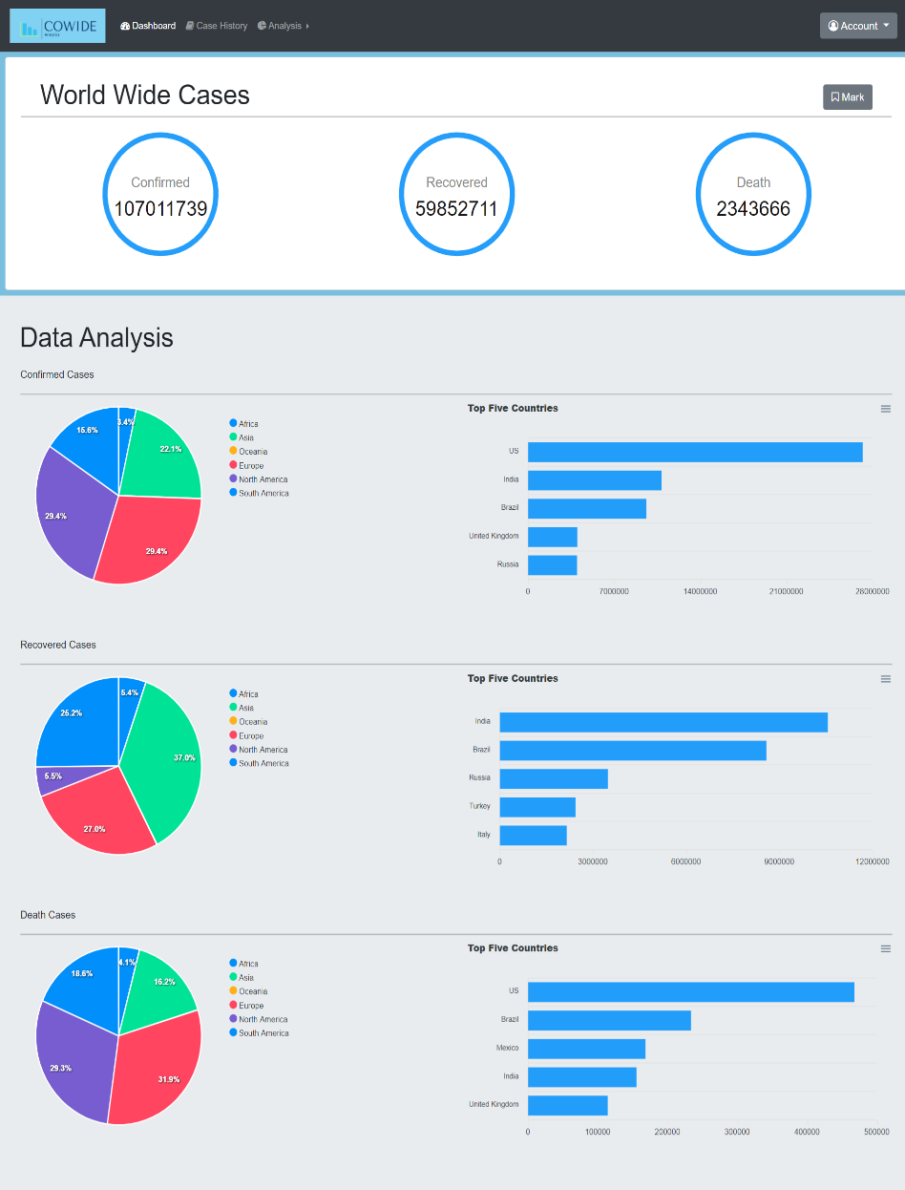
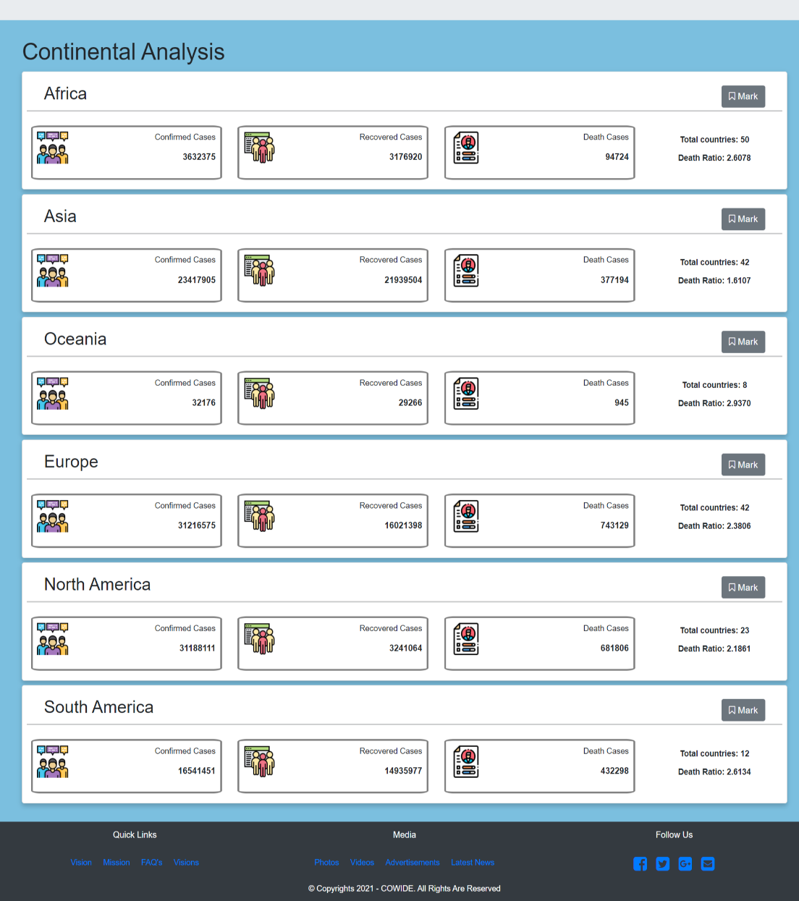
OUTCOME

Slide 10
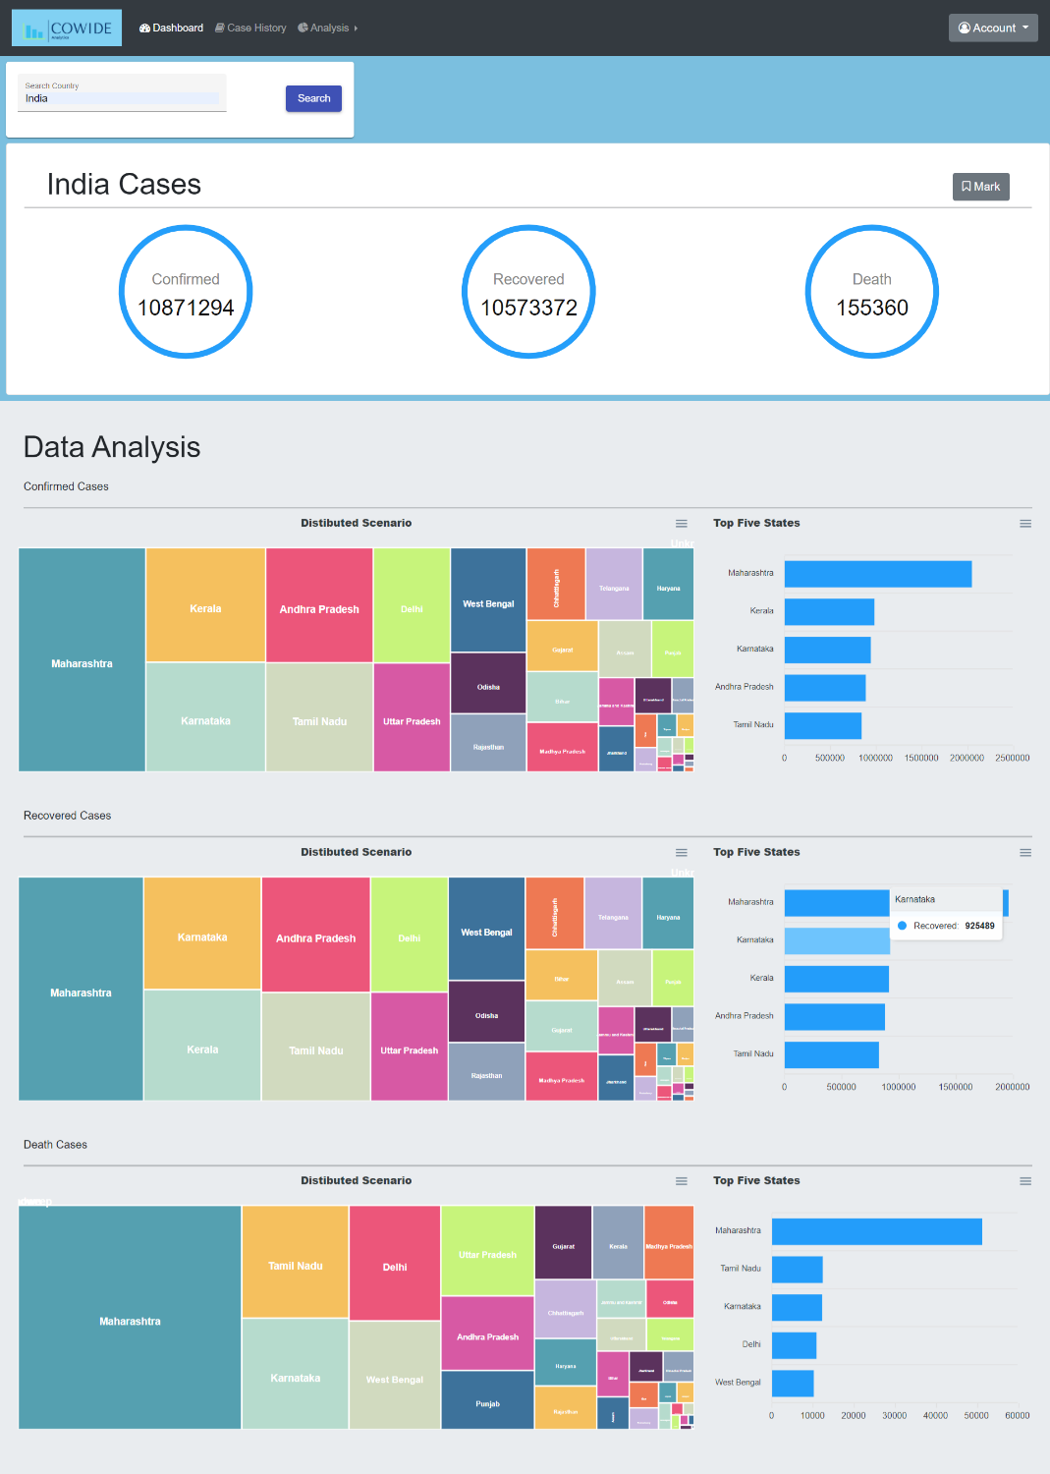
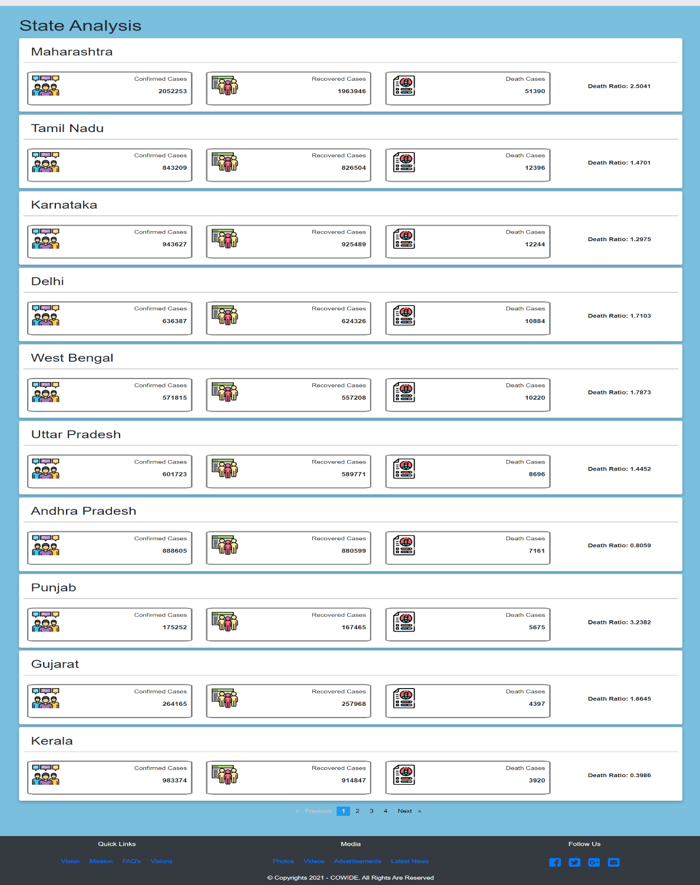

Slide 11
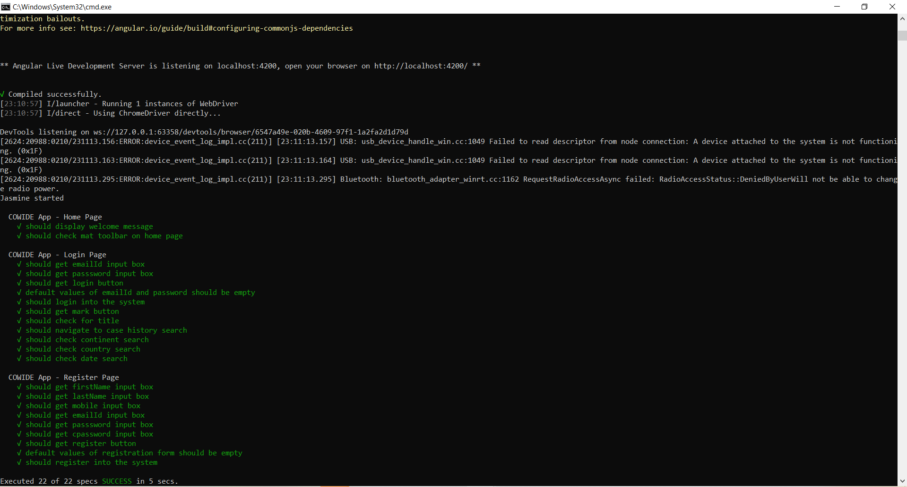
TEST CASE RESULTS
Angular E2E Test Case:

Slide 12
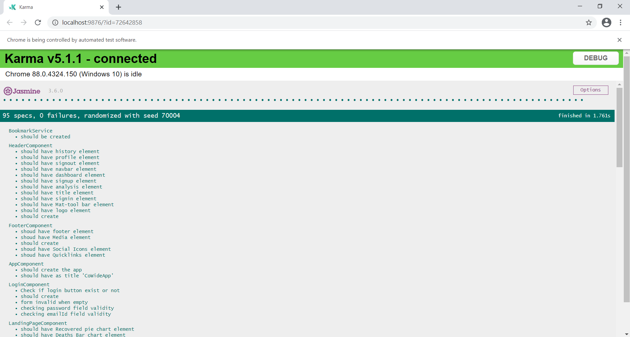
Angular Unit Test Cases:

Slide 13
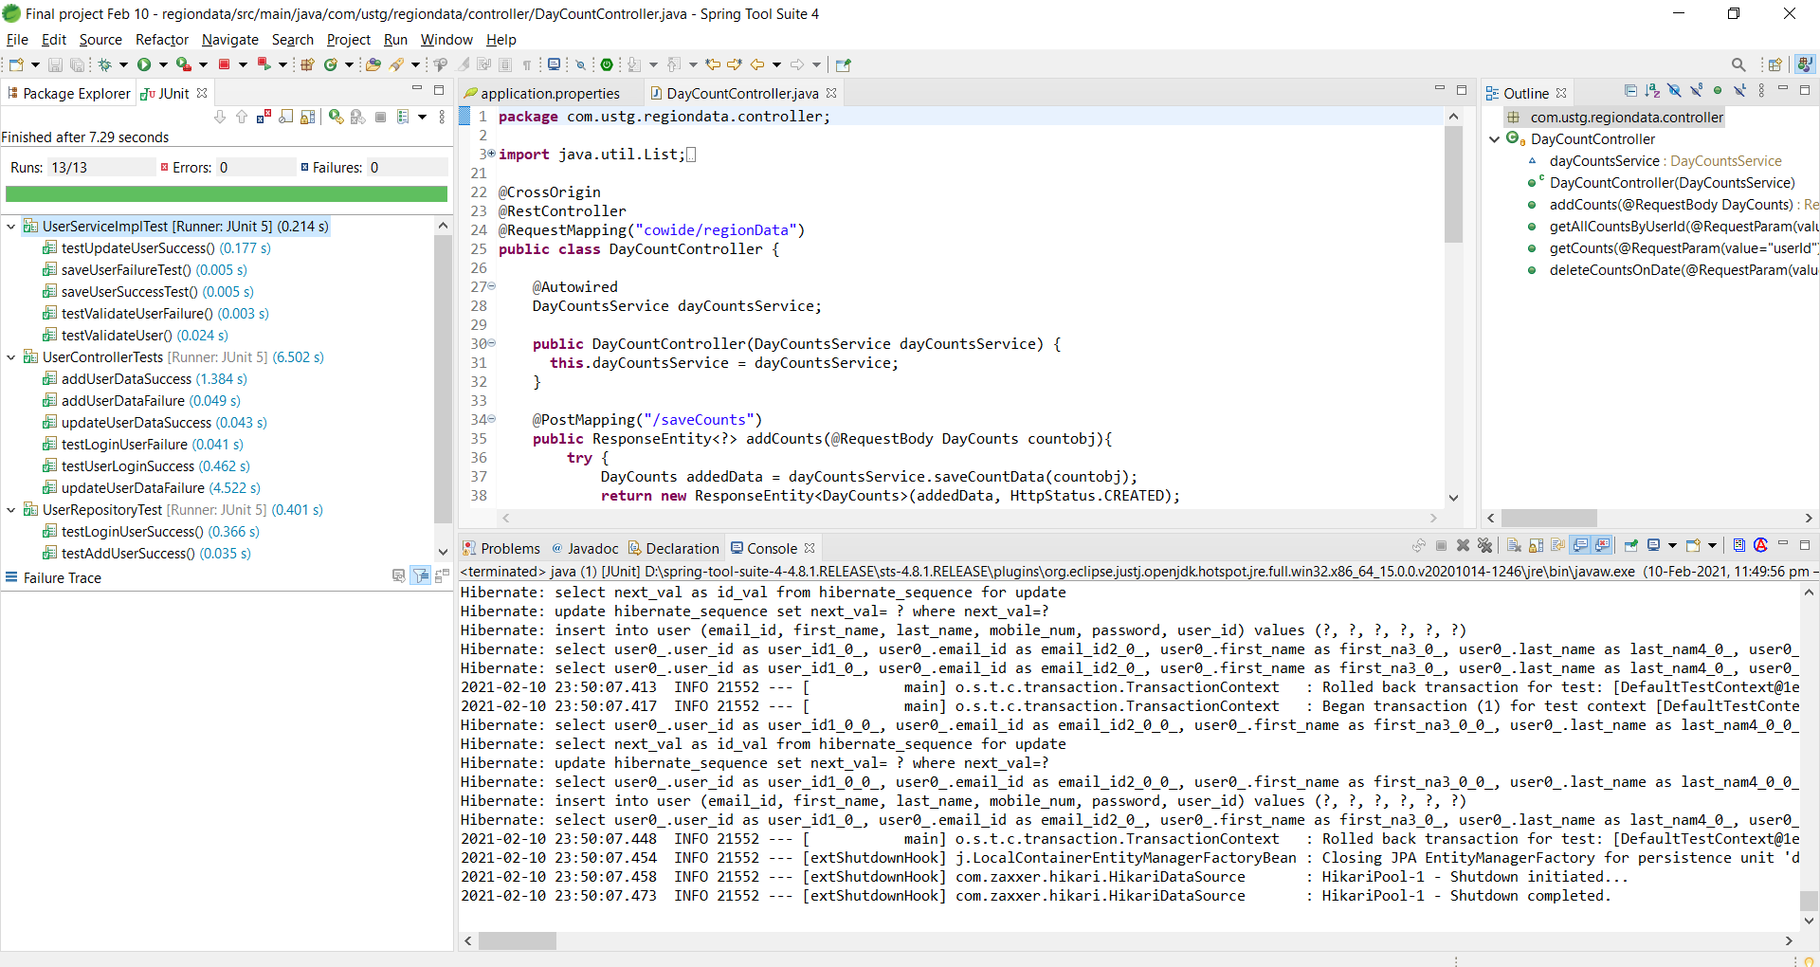
UserAuthentication Service Test Cases:

Slide 14
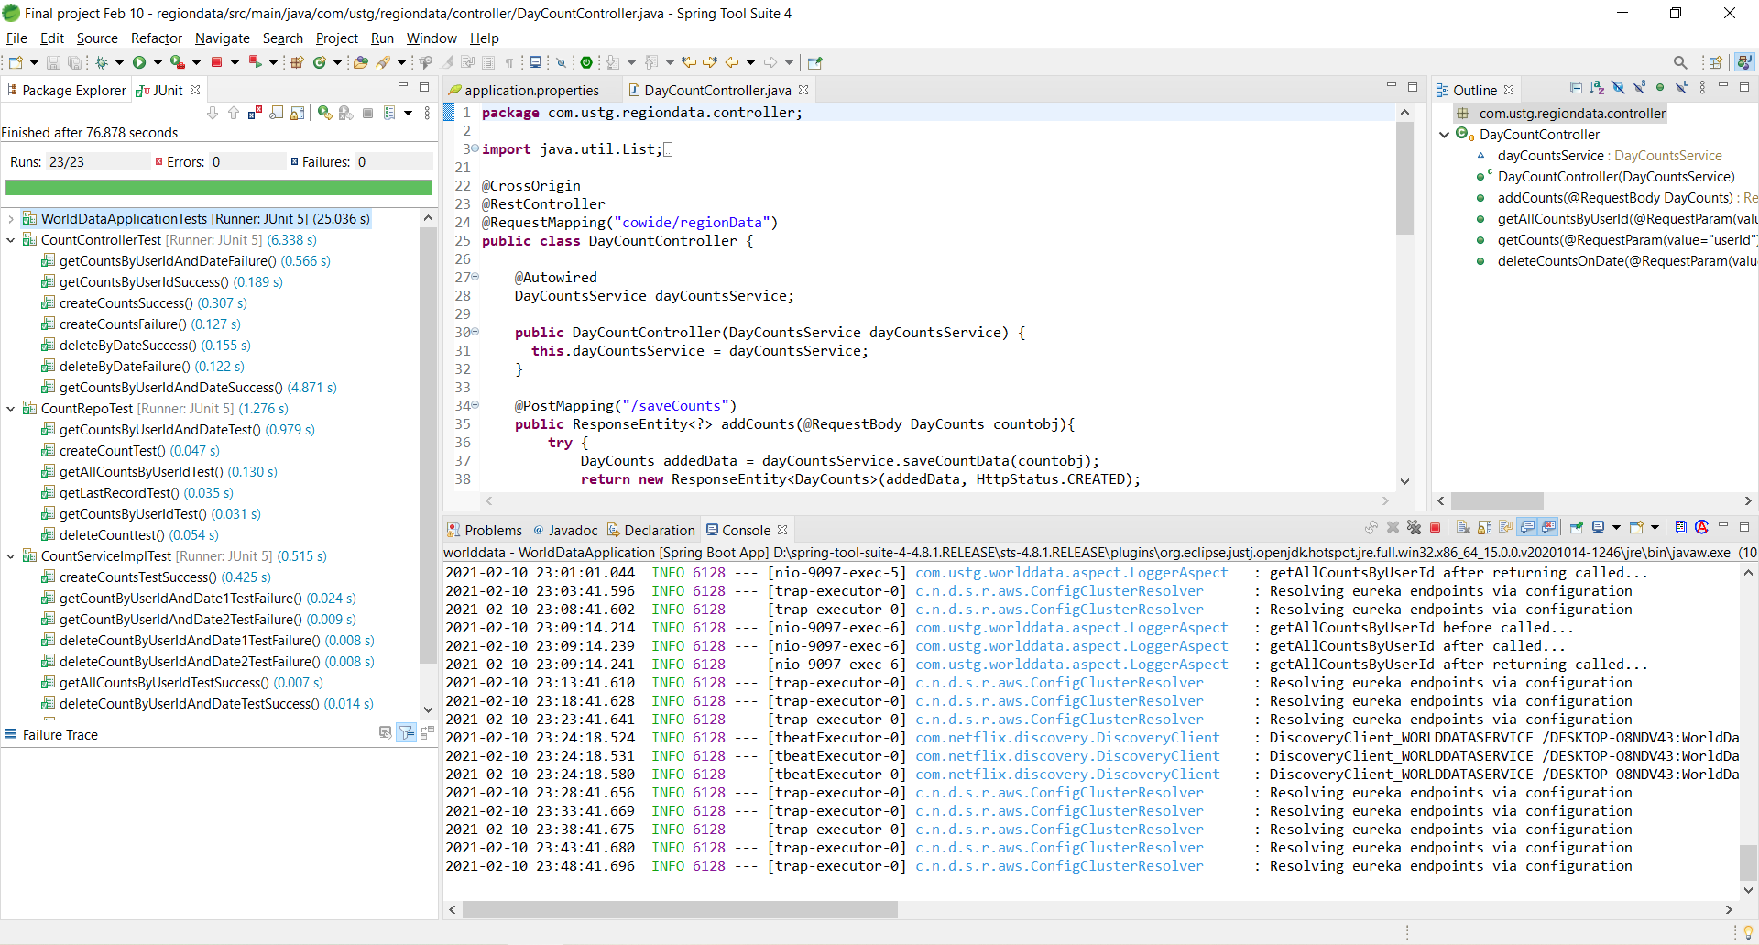
WorldData Service Test Cases:

Slide 15
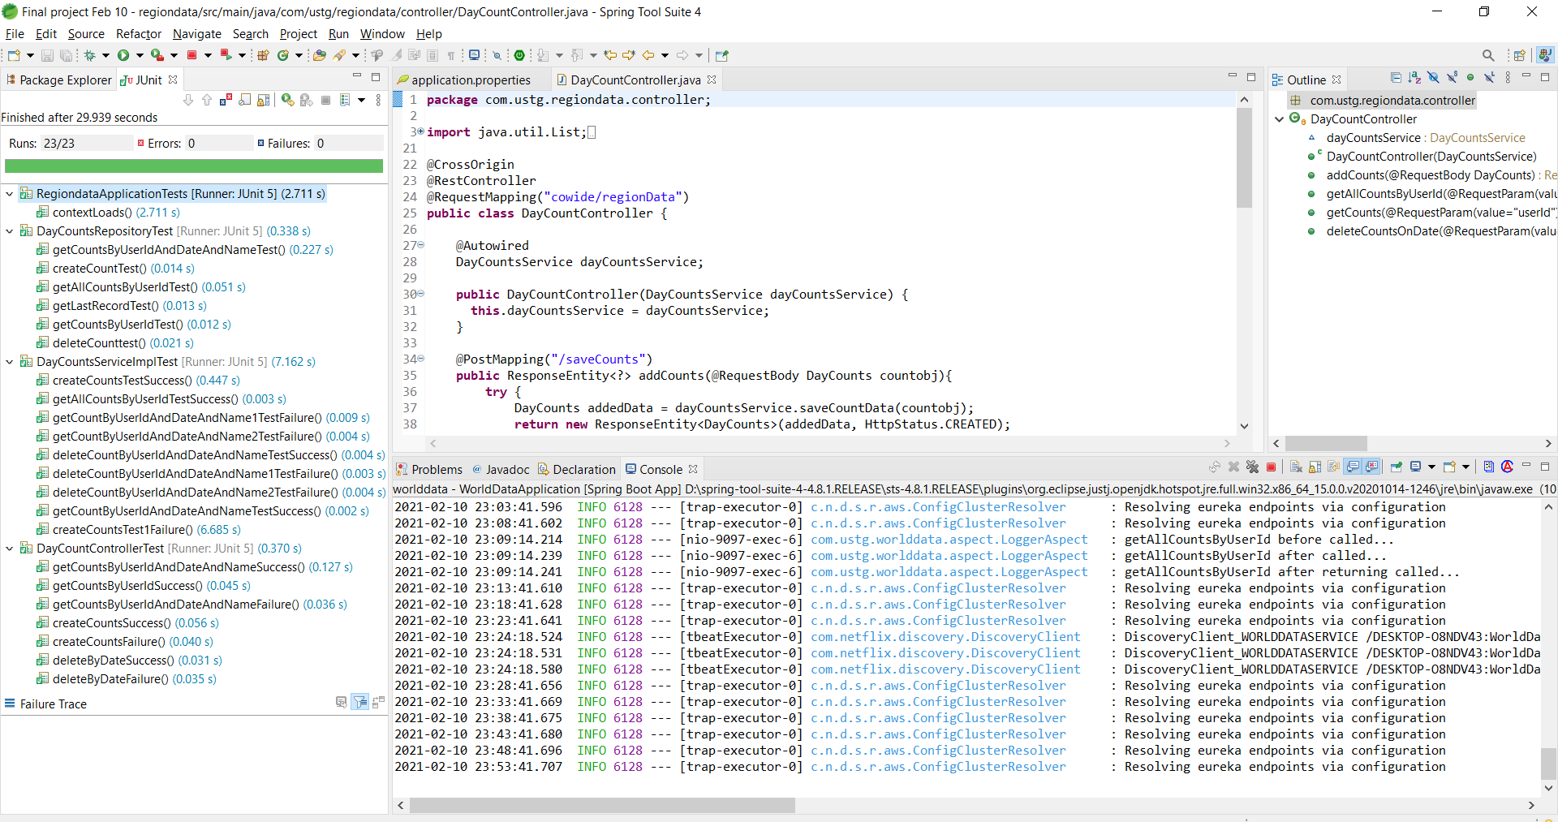
RegionData Service Test Cases:

Slide 16
PHASES & TIMELINE
Implementation :
Show World Wide Cases Scenario and Graphical Representation
Data Analysis – Continent, Country and Date
Display Top Five in Confirmed, Recovered and Death Cases respectively.
Flagging case data for further analysis.
Future Aspects:
State based and location based analysis.
Search based on date range

Slide 17
CONCLUSIONS & FUTURE DIRECTIONS
Real Time Data Analysis and Visualization of COVID-19 cases has been implemented successfully.
Comparative and Graphical Analysis of confirmed ,recovered and deaths between different Continents, Countries and Dates.
To make use Location Based API’s to retrieve data about user location.
To provide deep down analysis based on states, territory and sectors.
To provide Location based analysis to alert users about hot zones around their locality.

